Slide 1
Movie
Recommendation System
Team Name: Next Movie
Kalin Pu, Jiazhen Tang, Xiangshi Sun, Liang Han, Yiqin Zhu

Slide 2
Project Introduction
What we do: movie recommendation system and movie revenue prediction
Movie recommendation system would be used mainly for users who would like to watch movies, and revenue prediction system for investors.
Demographic-based filtering and content-based filtering
Explore the database and make meaningful recommendations on a list of movies that the user may enjoy base on the content and popularity of the entries.

Slide 3
Team Members Introduction
Liang Han, Silicon Valley campus
Jiazhen Tang, Silicon Valley campus
Kalin Pu, Silicon Valley campus
Xiangshi Sun, Boston campus
Yiqin Zhu, Silicon Valley campus

Slide 4
Method - Predicting Movie Revenue
1.Plot the average movie revenue by genres.
2.Split data into train and test model based on the year the movie launched, basically we are using historical revenue data to predict more recent movie revenue data.
3. Regression
4. Test coefficient significance
5.Test on our test data set
6.Plot predicted revenue with actual revenue
7. Boxplot the top highest rating movie by genres

Slide 5
Method - Predicting Movie Revenue
recommend the movies generally for all the users.
recommend a list of movies they may like or watch based on a movie users enjoy or watched.

Slide 6
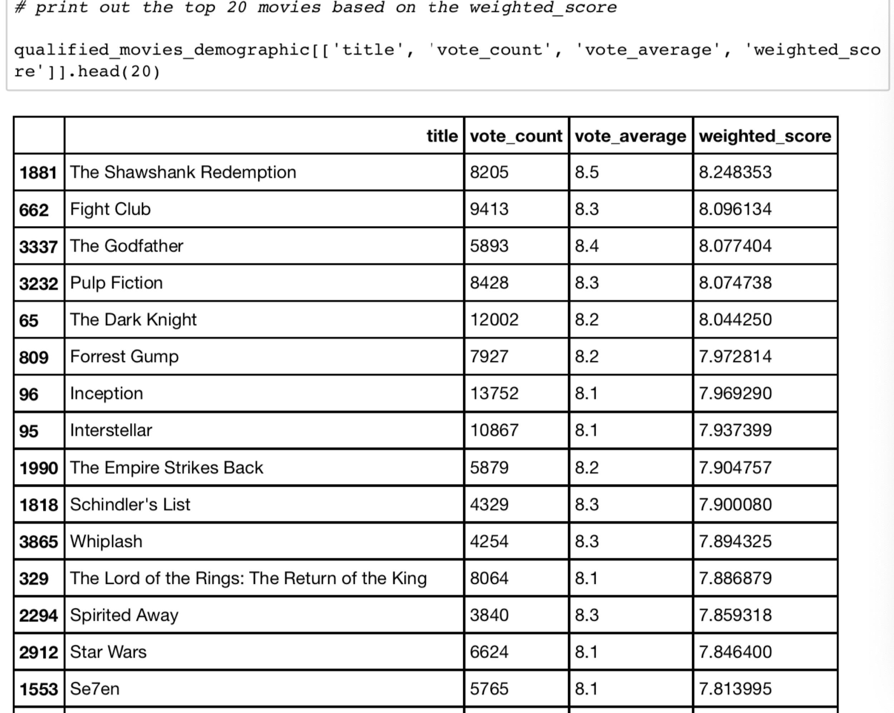
Data and Experiments
Demographic Filtering -
Trending now for All Users

Slide 7
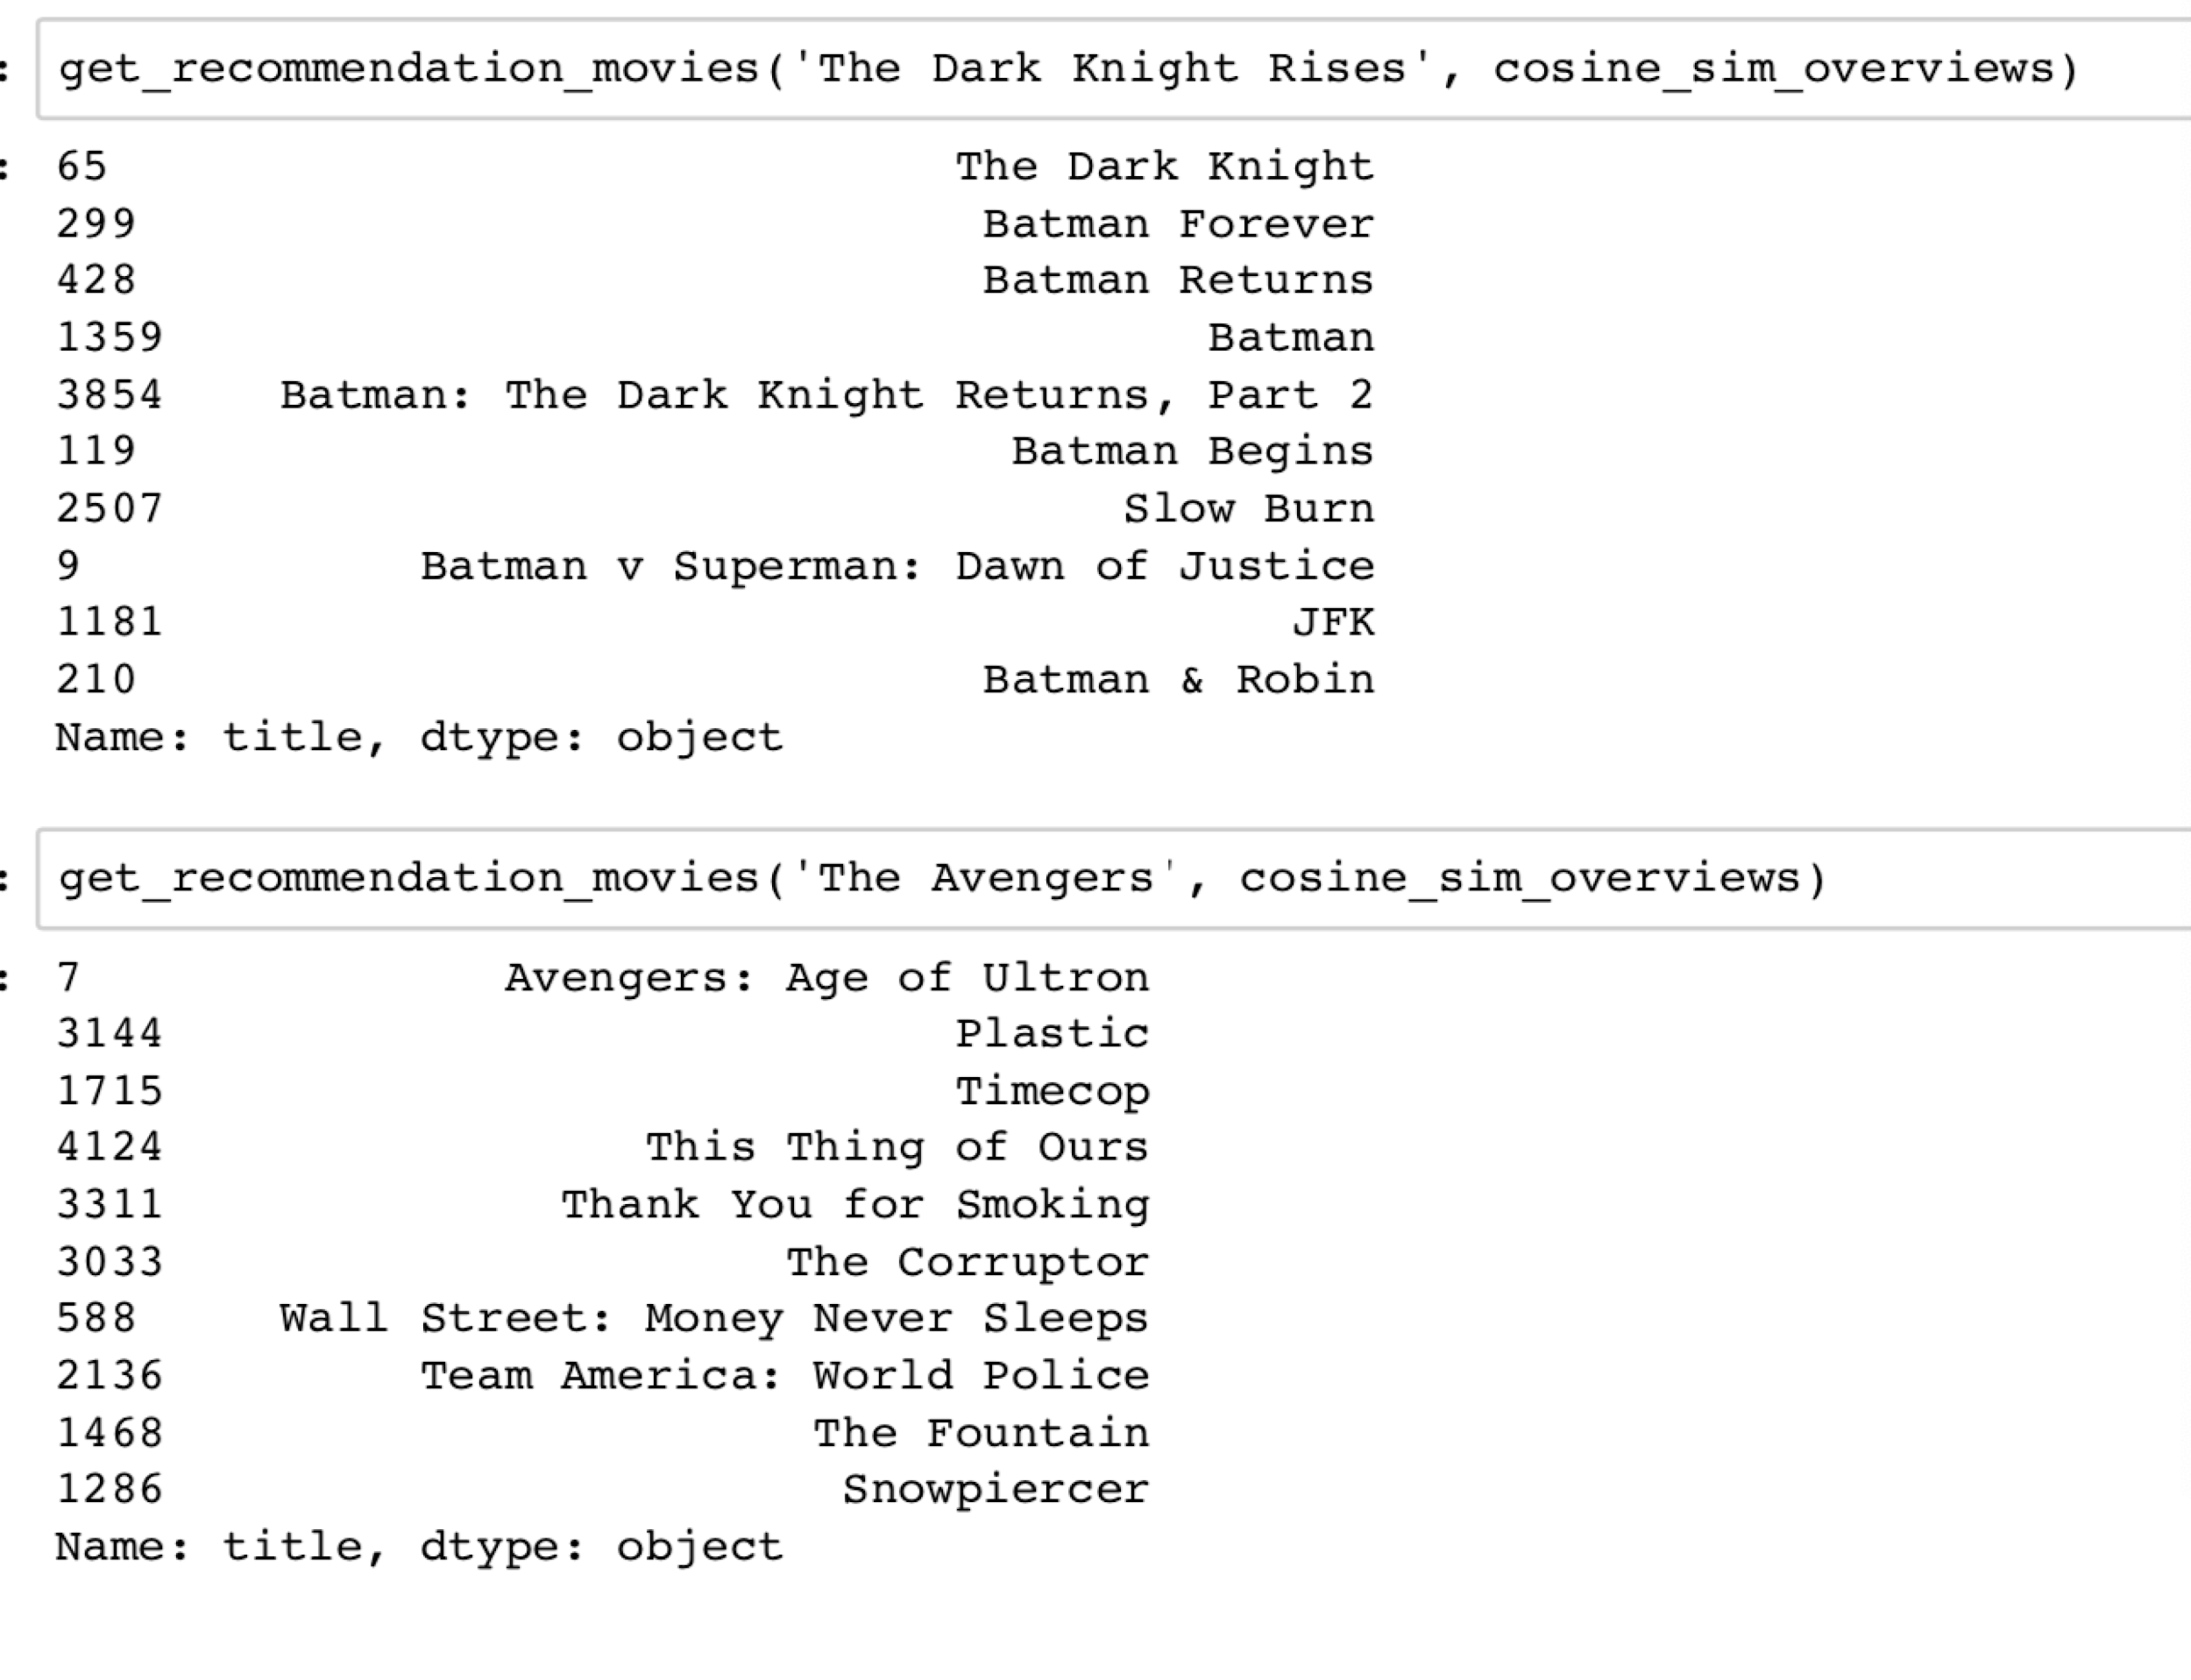
Data and Experiments
Content Based Filtering - using Movie Overviews

Slide 8
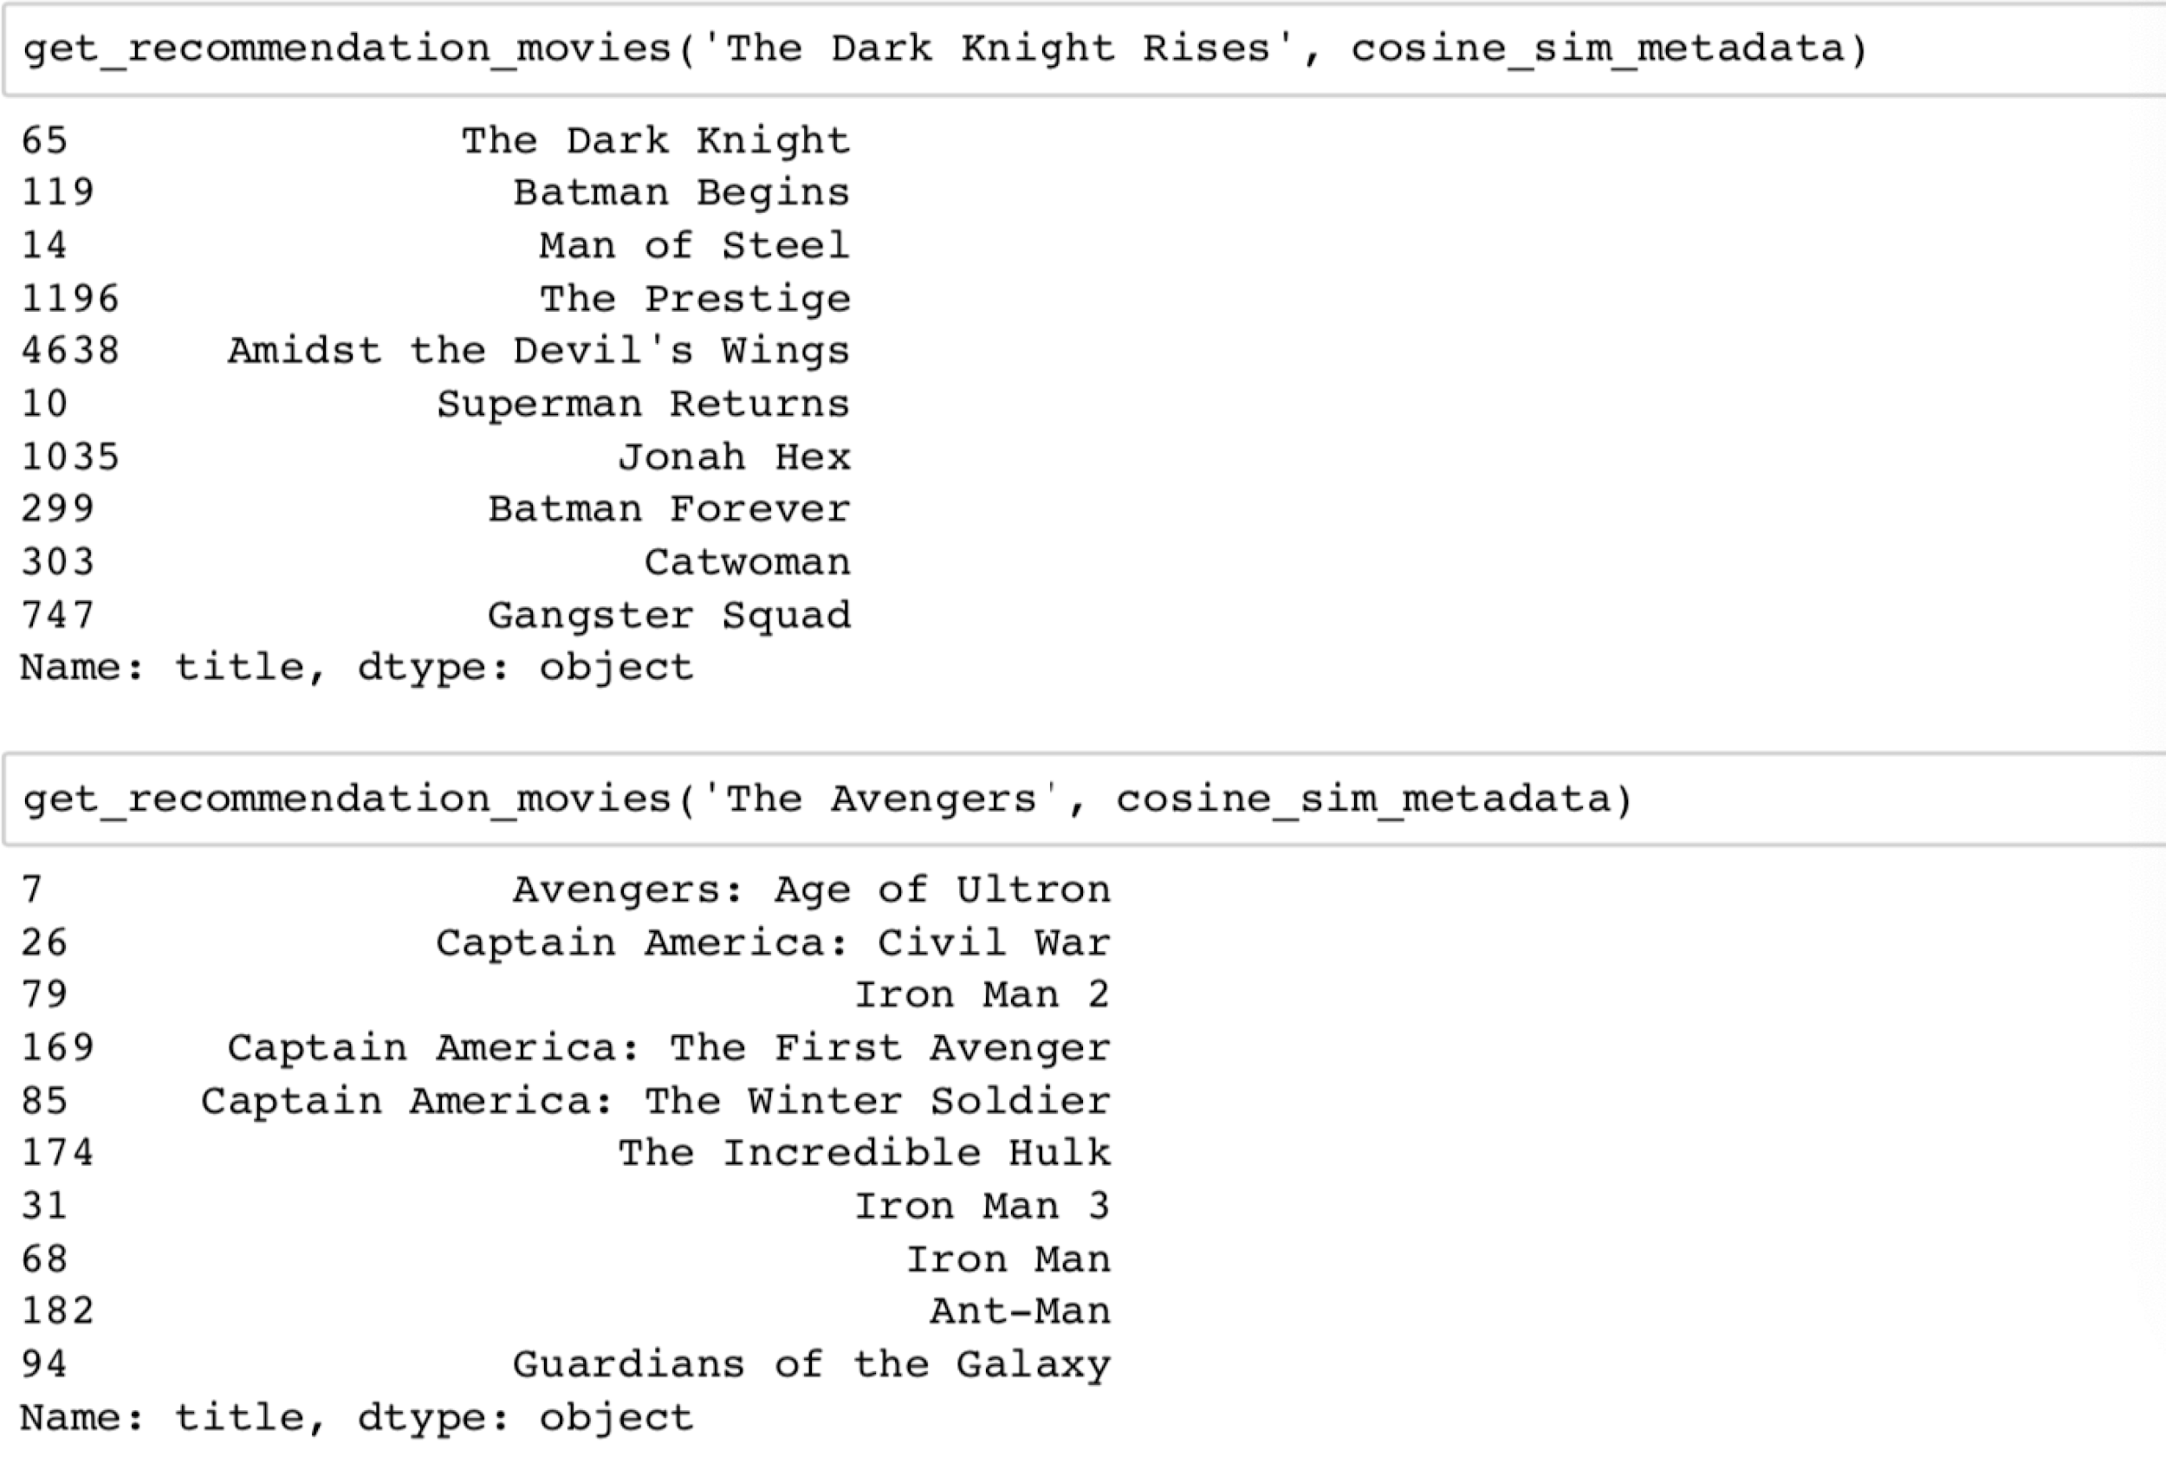
Data and Experiments
Content Based Filtering - using Movie Metadata ('genres', 'keywords', 'cast', 'crew', 'production_companies')

Slide 9
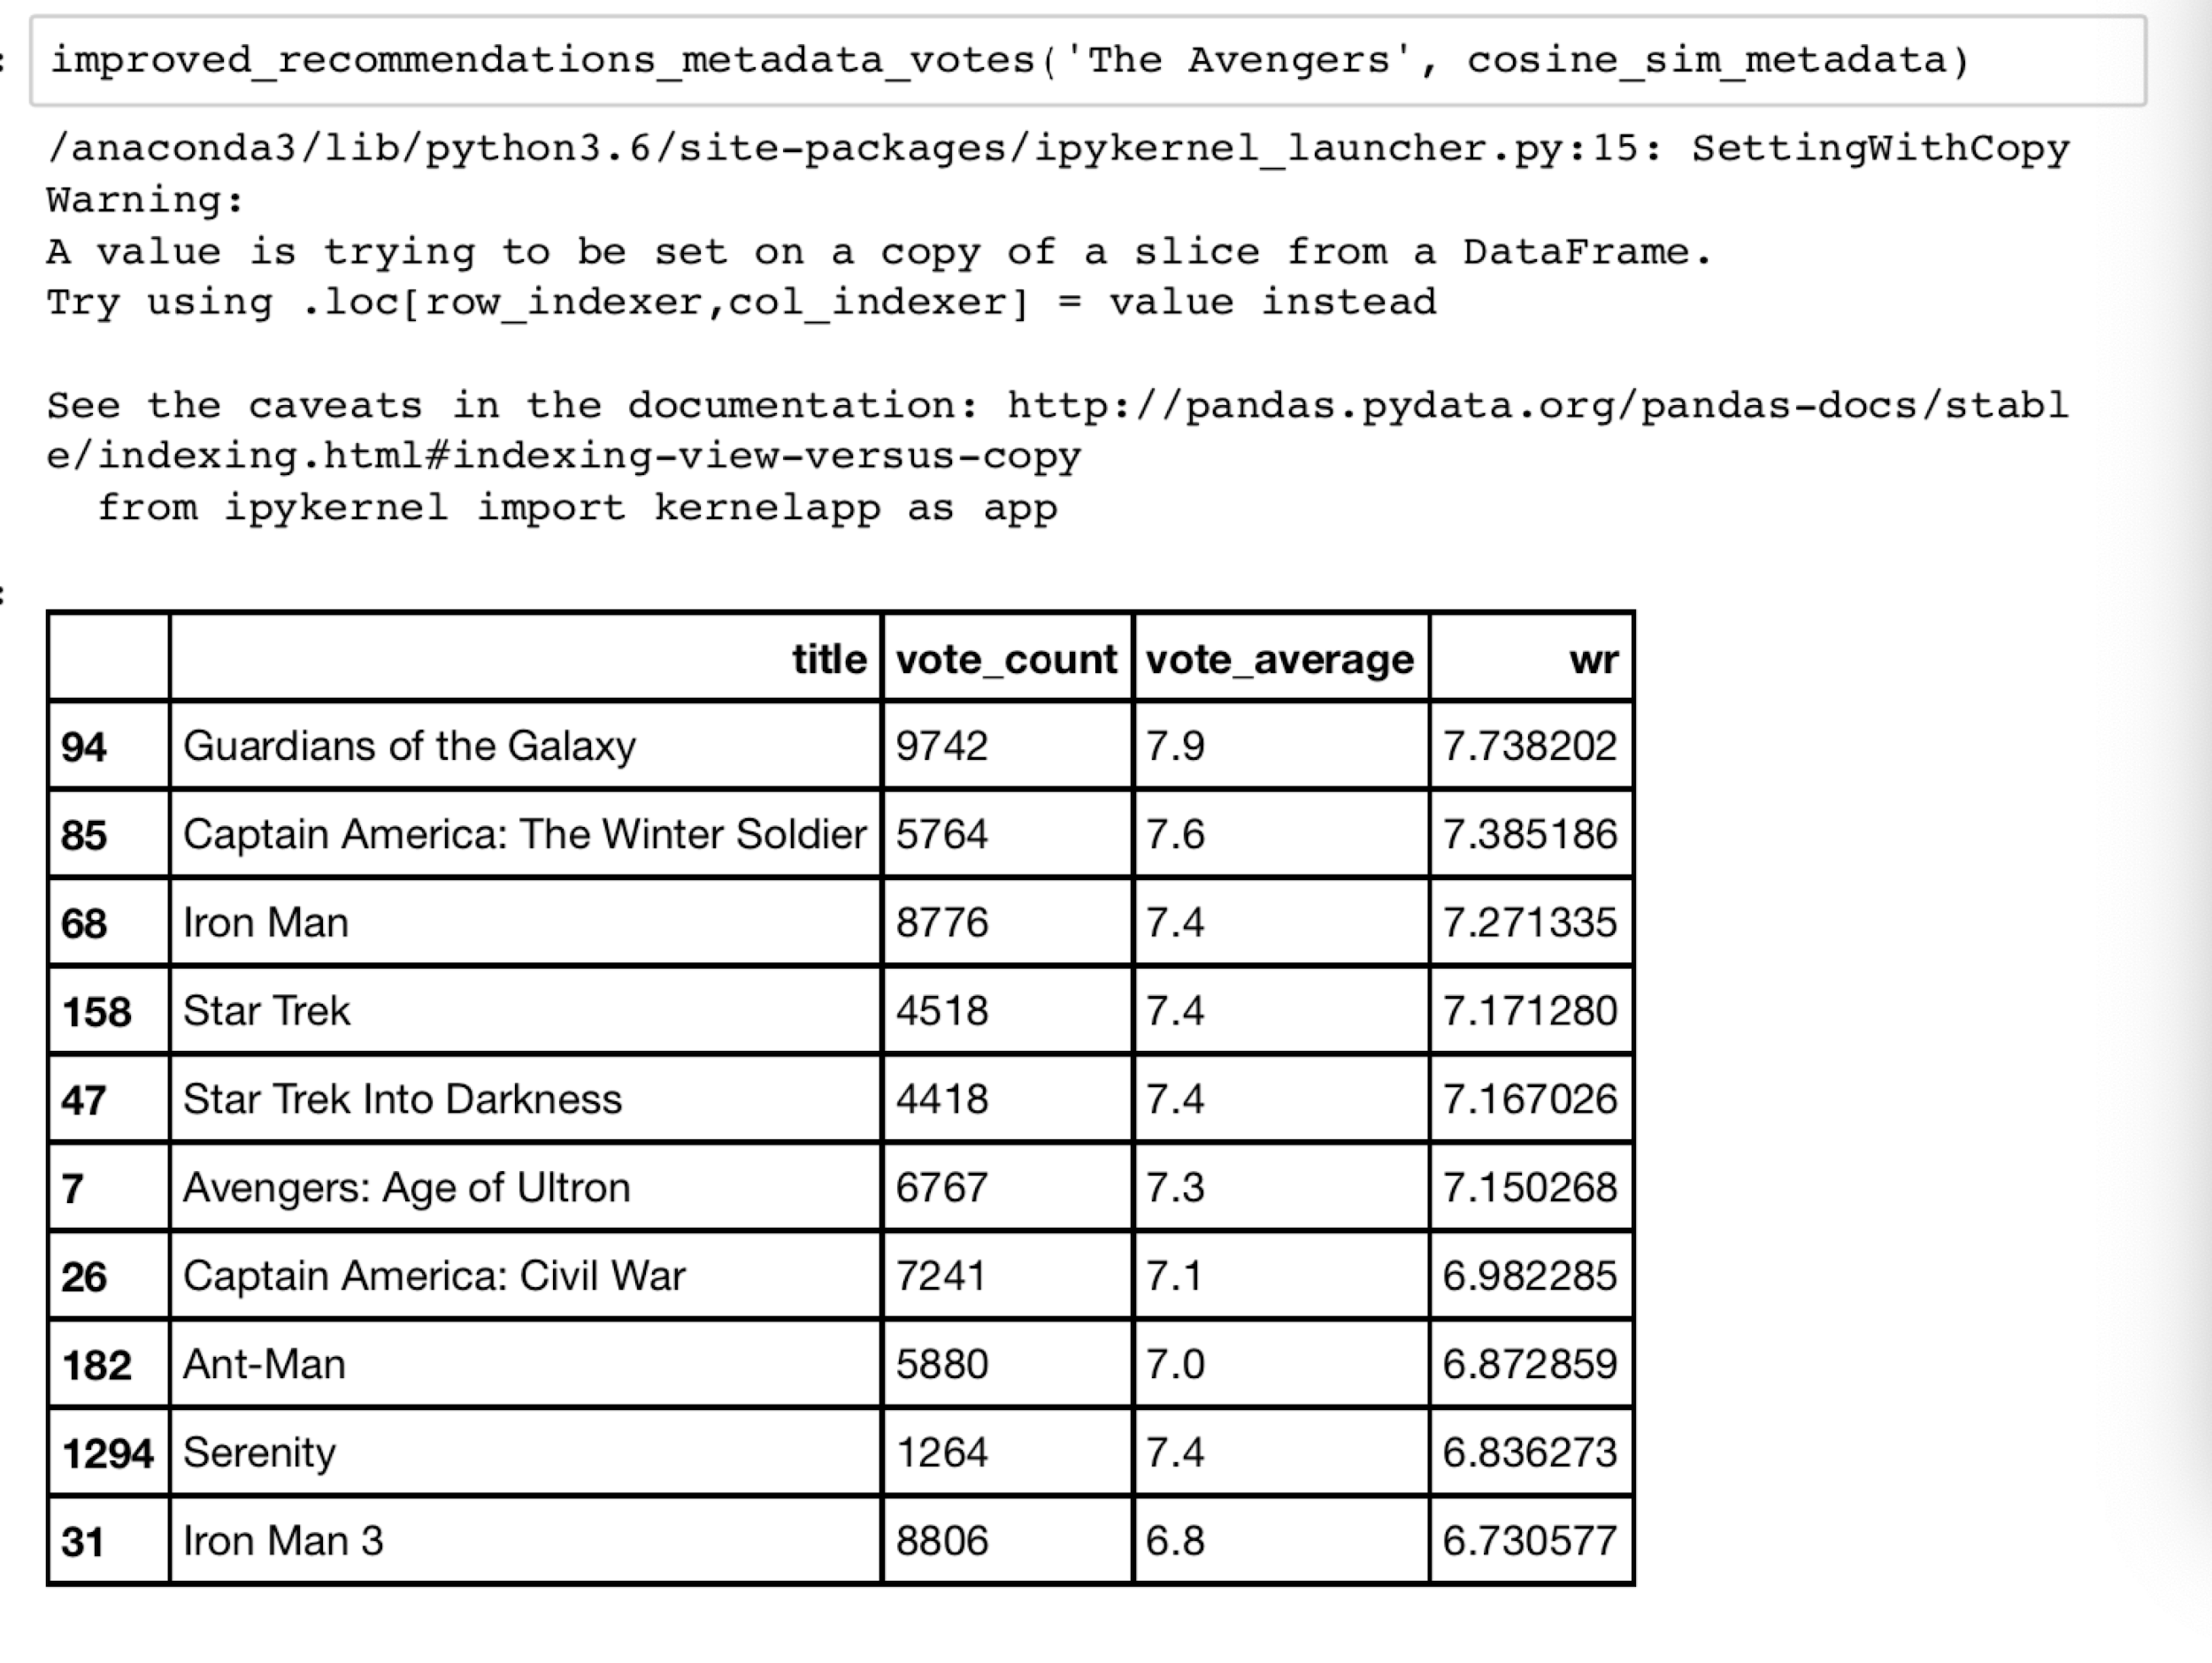
Data and Experiments
Content Based Filtering - using Movie Metadata ('genres', 'keywords', 'cast', 'crew', 'production_companies') and voting scores

Slide 10
Methods in our project
Recommendation system will be implemented using both demographic-based filtering and content-based filtering.
used TMDB 5000 movie dataset, load the dataset and transfer the data format from JSON to pandas dataframe
visual exploration of the data
information on the columns types in the dataset

Slide 11
Brief explanation of the code
1. What characteristics of a movie generate higher revenue.
2. Average movie ratings for some specific production companies.
3. Average movie ratings for some specific production countries.
4. Top 100 most revenue movies
5. Top 100 most commented movies

Slide 12
Let’s move to the jupyter notebook

Slide 13
From the code recommendation we can see that use weighted rating to generate recommendations based on the user demographic attributes.
# calculate weighted rating score for each movie we have
qualified_movies_demographic['weighted_score'] = qualified_movies_demographic.appl
y(weighted_rating_score, axis=1)

Slide 14
Movie recommendation results from Demographic Based method
the movies we recommend are all have a large amount of review counts and high review scores.
use a weighted rating score formula to calculate each movies’ score.
Result of demographic based method:
Recommended are The Shawshank Redemption”, “Fight Club”, “The Godfather”, “Pulp Fiction”, “The Dark Knight” and “Star Wars”.

Slide 15
Evaluation and Results - Recommendation
Movies Recommendation Results Analysis
Demographic Based method
Content Based method using Movie Overviews
Content Based method using Movie Metadata
Content Based method using Movie Metadata and vote scores

Slide 16
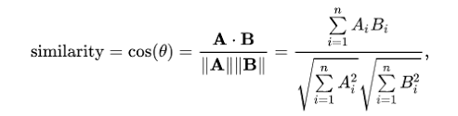
Content Based Filtering - using Movie Overviews
Overall, we compute pairwise similarity scores for all movies based on the overviews
1st, we compute Term Frequency-Inverse Document Frequency (TF-IDF) vectors for each overview
2nd, we compute cosine similarity, a numeric quantity, that denotes the similarity between two movies

Slide 17
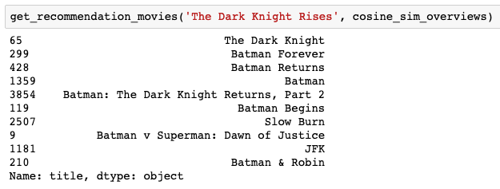
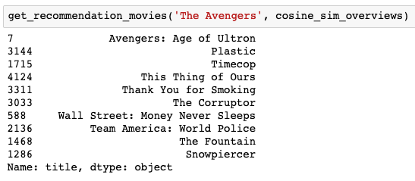

Slide 18
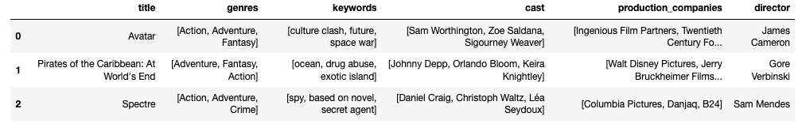
Content Based Filtering - using Movie Metadata
parse the stringified features into python objects and build features list
use the CountVectorizer() instead of TF-IDF, don’t want to down-weight the presence of an element

Slide 19
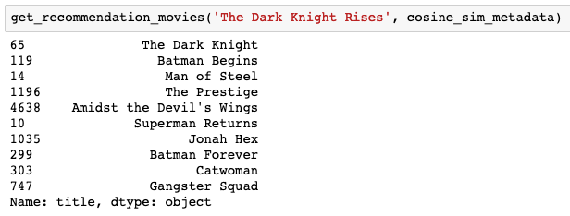
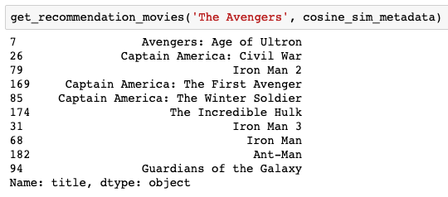

Slide 20
Content Based Filtering - using Movie Metadata and voting scores
besides similarity, the ratings and popularity of a movie should be considered as well
add a mechanism to remove bad movies and recommend high rated similar movies

Slide 21
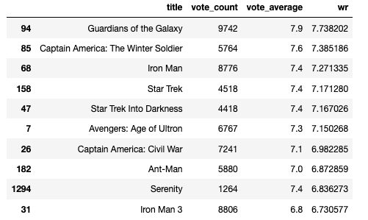

Slide 22
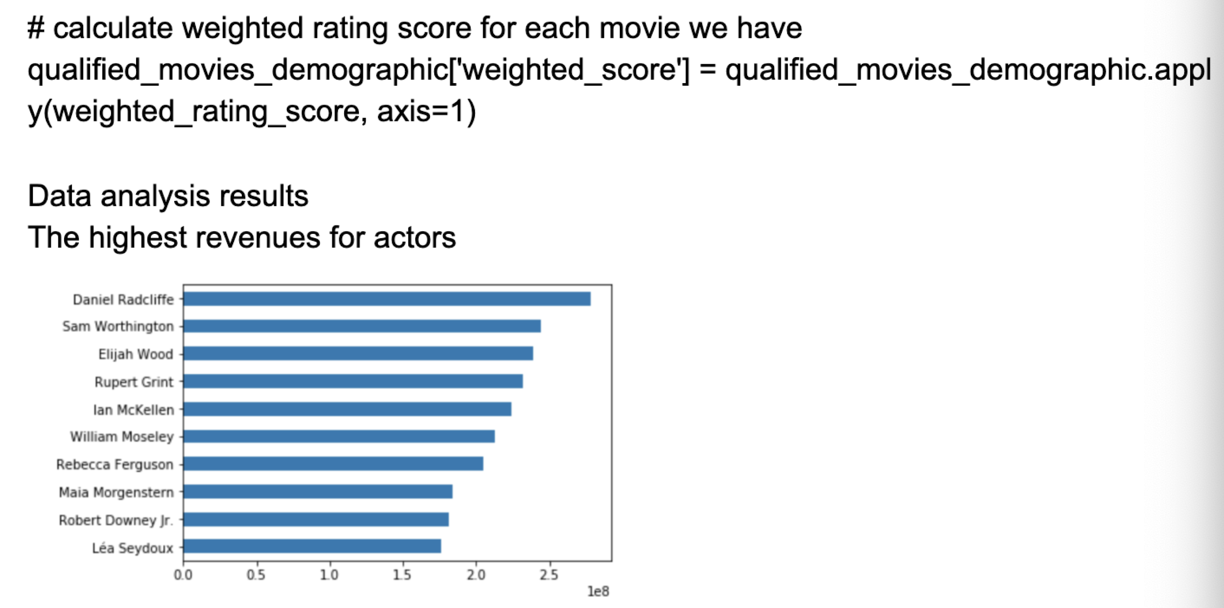
Evaluation and Results - Revenue Prediction

Slide 23
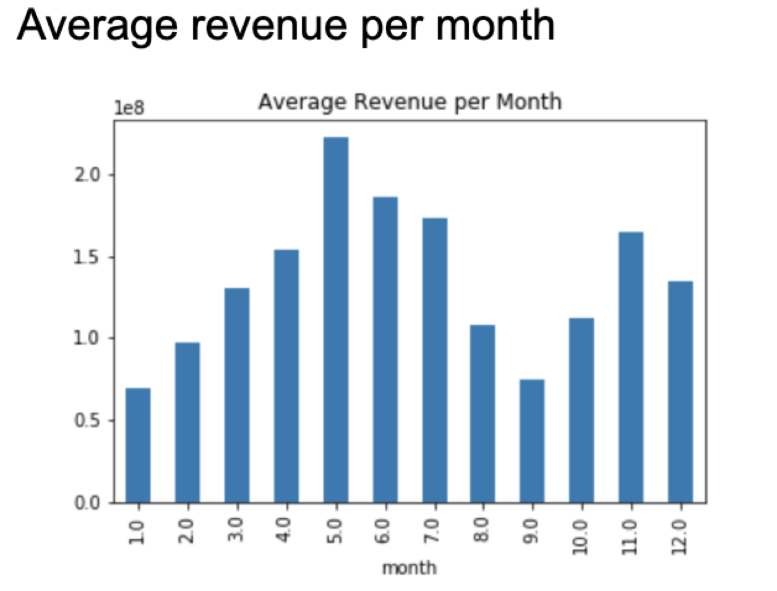
Evaluation and Results - Revenue Prediction

Slide 24
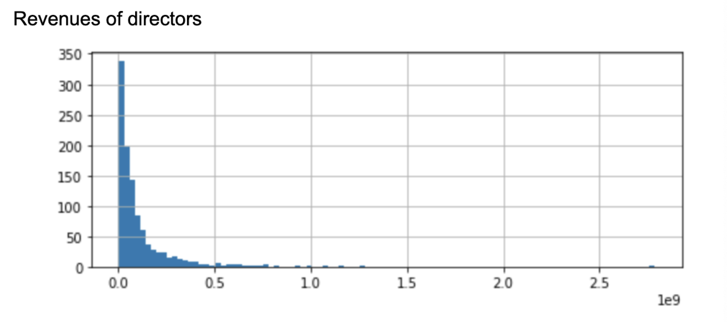
Evaluation and Results - Revenue Prediction

Slide 25
Evaluation and Results - Revenue Prediction
Movie Revenue Prediction
1. Revenue = 140682 * budget + 2289*release date + 775034*run time + 268278 *vote count – 1562024 * vote average
2. Revenue = 166008 * budget - 10344*release date + 470666*run time + 288108 *vote count – 1346243 * vote average

Slide 26
Discussion - Movie Recommendation
Recommendation results from Demographic Based method
Recommendation results from Content Based method using Movie Overviews.
Recommendation results from Content Based method using Movie Metadata
Recommendation results from Content Based method using Movie Metadata and vote scores

Slide 27
Discussion - Revenue Prediction
Interpretation of modes
1. Revenue = 140682 * budget + 2289*release date + 775034*run time + 268278 *vote count – 1562024 * vote average
2. Revenue = 166008 * budget - 10344*release date + 470666*run time + 288108 *vote count – 1346243 * vote average
Comparison and key observations:
Release date has more explanatory power than year in our prediction
Drama films are earning less in recent year (>2010).

Slide 28
Future Work
Combine the advantage of demographic-based filtering and content-based filtering
More weights can be added towards the director perspective in content-based approach
Movies recommendation using metadata can be improved, besides meta data similarity,
Learn more data and resources from actors, directors and investors to improve the completion of model

Slide 29
Summary
Demographic-based filtering and content-based filtering techniques work efficiently with our project
Experiment and result show the success of revenue prediction and recommendation system work properly
Solutions have met the expectations

Slide 30
Thank You!

